Slide 1
http://www.vidyanidhi.com/
ketkiacharya.net@gmail.com
Ketki Acharya
From: SM VITA ATC of CDAC
9769201036
ketkiacharya.net@gmail.com

Slide 2
Basic example

Slide 3
using System; //it is name space(Logically grouping of class and avoid name collision )
namespace Basics
{
class MyFirstCSharpClass // class having Main is called entrypoint class
{ static void Main() //M of Main is capital
{
//Console is static class and WriteLine is static method
Console.WriteLine(“Hello world ");
}
}
}
signature for Main(); method.
public static void Main(String [] args)
public static void Main()
private static void Main()
static void Main()
------------------------------------------
public static int Main(String [] args)
public static int Main()
private static int Main()
static int Main()
in above you have to write return 0;
In the above example when you compile your code, CLR can call static method of MyFirstCSharpClass. Since method is static it can call without creating object of that class. As you know static data resides in external memory block.
What is class?
It is user define data type
What is the extention of c# file
.cs
Command to compile c# file
csc filename.cs you will get filename.exe file

Slide 4
When you compile a C# application
When you compile a C# application or any application written in a CLS-compliant language, the application is compiled into MSIL. This MSIL is then further compiled into native CPU instructions when the application is executed for the first time by the CLR. (Actually, only the called functions are compiled the first time they are invoked let's look at what's really happening under the hood:
You write source code in C#.
You then compile it using the C# compiler (csc abc.cs) you will get abc.exe file
The C# compiler outputs the MSIL code and a manifest into a read-only part of the EXE that has a standard PE (Win32-portable executable) header.
So far, so good. However, here's the important part: when the compiler creates the output, it also imports a function named _ CorExeMain from the .NET runtime.
When the application is executed, the operating system loads the PE, as well as any dependent dynamic-link libraries (DLLs), such as the one that exports the _ CorExeMain function (mscoree.dll), just as it does with any valid PE.
The operating system loader then jumps to the entry point inside the PE, which is put there by the C# compiler. Once again, this is exactly how any other PE is executed in Windows.
However, since the operating system obviously can't execute the MSIL code, the entry point is just a small stub that jumps to the _ CorExeMain function in mscoree.dll.

Slide 5
The _ CorExeMain function starts the execution of the MSIL code that was placed in the PE.
_CorExeMain or _CorDllMain performs the following actions:
Initializes the CLR.
Locates the managed entry point from the assembly's CLR header.
Begins execution.
Since MSIL code cannot be executed directly—because it's not in a machine-executable format—the CLR compiles the MSIL by using a just-in-time (JIT) compiler (or JITter) into native CPU instructions as it processes the MSIL. JIT compiling occurs only as methods in the program are called. The compiled executable code is cached on the machine and is recompiled only if there's some change to the source code.

Slide 6
using System; //it is a name space
namespace ConsoleApplicationDemo
{ class myclass
{ //public instance method - you can call this method through object of this class
public int sum(int x, int y)
{ return x + y; }
}
class Program //Entry point class
{ static void Main(string[] args)
{ int x; //local variable -green underline indicate warnning
//bellow line will give error because you can not use variable without initializing
//if you remove comment you will see red underline indicating error
//Console.WriteLine(x);
//creating object of a myclass //myobj is reference to the object-it resides on stack
//new myclass() is object - it resides on heap memory
myclass myobj = new myclass(); //new is same as malloc
//calling method using object reference
int result= myobj.sum(3, 4);
// + operator is overloaded it will concat
Console.WriteLine("result="+result);
Console.WriteLine("result={0}", result);
}
}
}
new myclass
5000
public int sum(int x, int y)
{ return x + y;
}
myobj
4000
2000
4000
5000
Reference
Object
Stack
Heap

Slide 7
Ildasm –Intermediate Language Disassembler will display metadata and MSIL code in readable format
How to start ILDASM
C:\Program Files\Microsoft SDKs\Windows\v6.0A\bin
click on ildasm file
open your exe file you will able to see some detail about classes ,methods etc
or
open visual studio command prompt
type
ildasm.exe it will open the window
Using file option open your exe file
Where exe file get created ?see the next slide

Slide 8
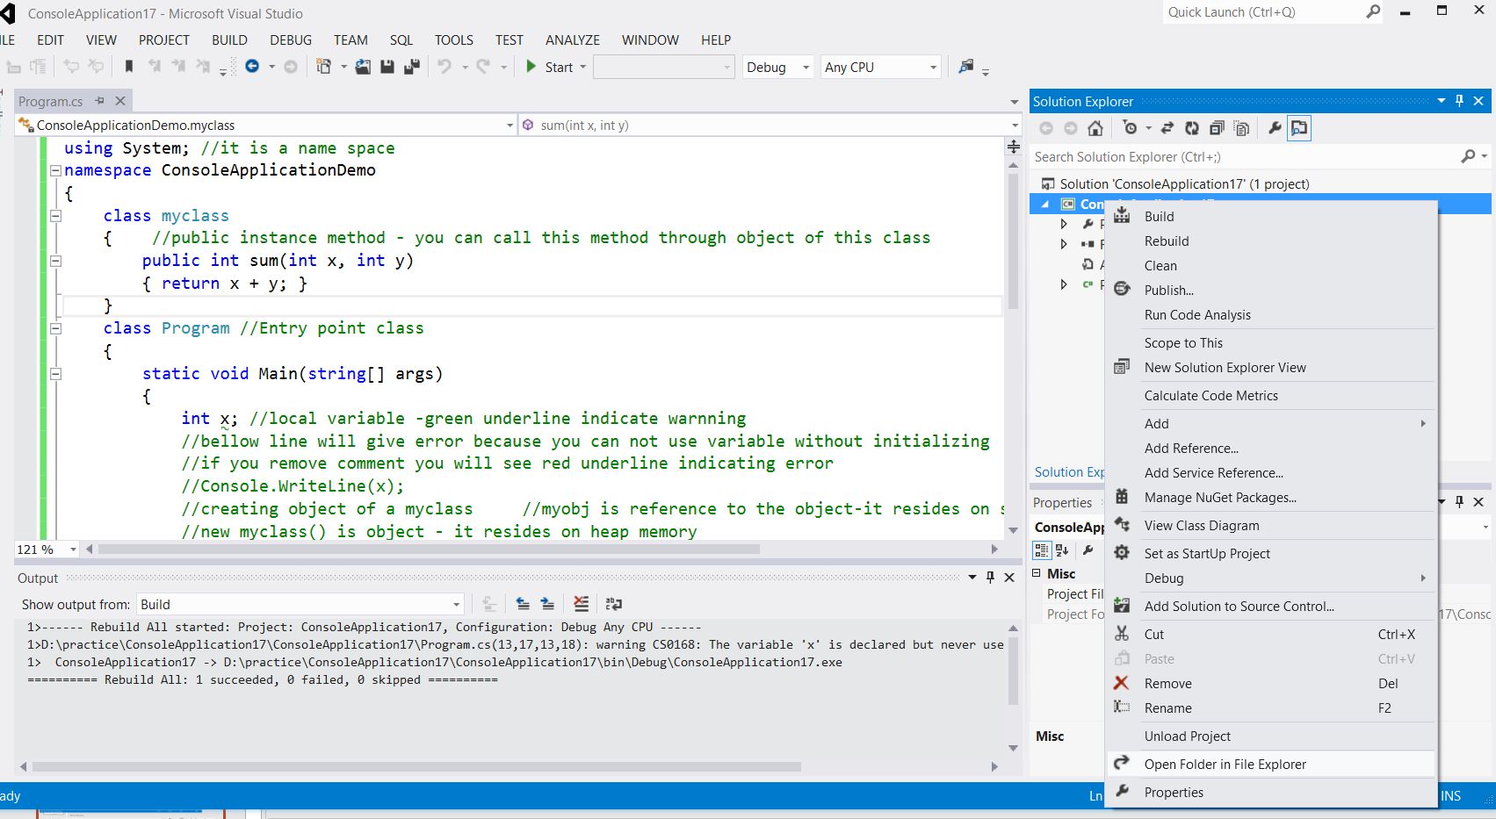
Right click on application and then click on open folder in file explorer

Slide 9
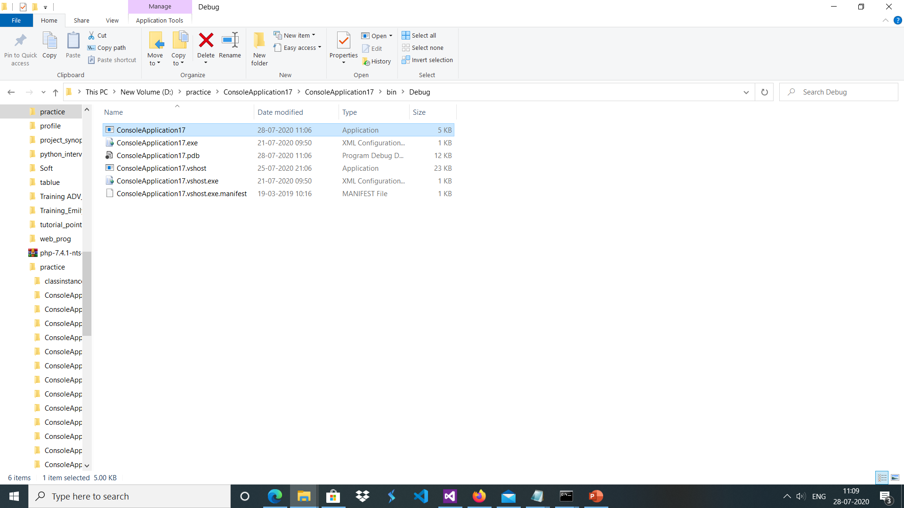
D:\practice\ConsoleApplication17\ConsoleApplication17\bin\Debug in debug folder you will see file with type Application. This file you have to open in ildasm

